Slide 1

The Evolution of Intel Processors
From the humble Intel 4004 to today's advanced Core Ultra Series, this presentation traces the transformative journey of processor technology that has powered computing for over five decades.

Slide 2





Agenda
Early Beginnings
The groundbreaking Intel 4004 and foundation of modern computing
x86 Architecture
The revolutionary 8086 and the architecture that changed computing
Pentium Era
Multicore processing and multimedia revolution
Core Architecture
Modern innovations and the Core Ultra series

Slide 3

The First Microprocessor: Intel 4004
Revolutionary Design
Technical Specifications
Historical Impact
Released in 1971 as the world's first commercial microprocessor, fitting all computing functions on a single chip.
4-bit processor with 2,300 transistors and 740 kHz clock speed using 10-micron fabrication technology.
Originally designed for a Japanese calculator but became the foundation for all modern processors.

Slide 4
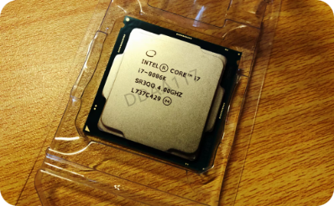
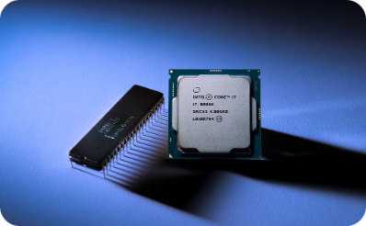
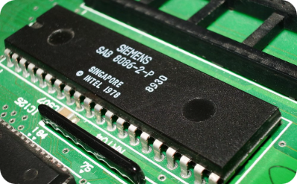
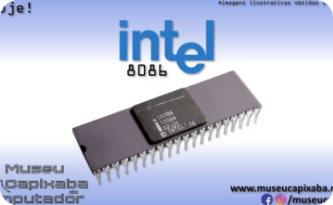
The Birth of x86: Intel 8086
16-bit Architecture
Performance
Memory
Legacy
Launched in 1978 as Intel's first 16-bit microprocessor.
Clock speeds up to 10 MHz, with 29,000 transistors on the chip.
Capable of addressing up to 1 MB of memory.
Established the enduring x86 architecture for decades of computing.

Slide 5





The Pentium Revolution
Superscalar Design
MMX Technology
High Performance
Introduced in 1993, enabling multiple instructions per clock cycle
Enhanced multimedia capabilities for audio, video, and graphics
Pentium 4 reached clock speeds up to 3.8 GHz
32-bit Computing
Mainstream adoption of 32-bit architecture for personal computers

Slide 6
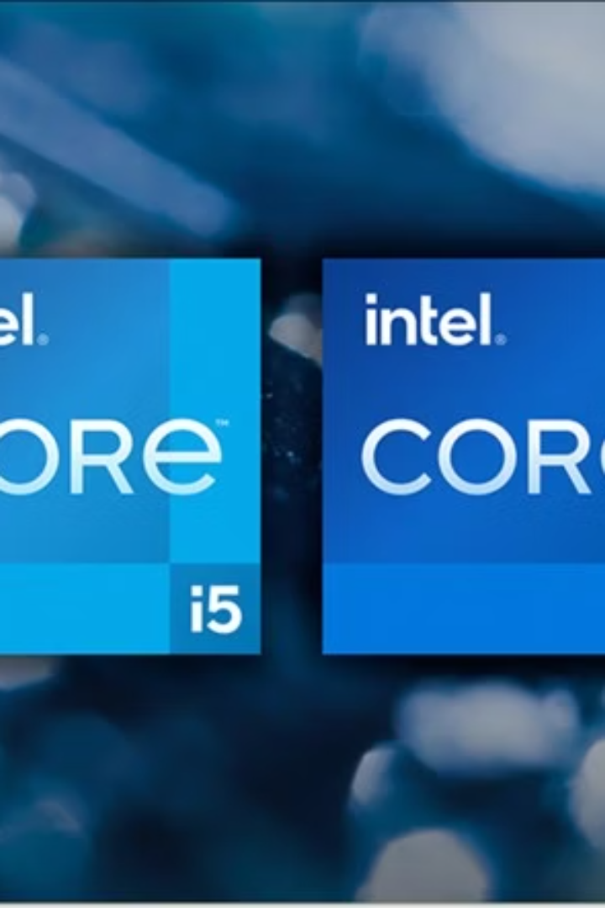




Intel Core Series: Multi-Core Era
Core Duo (2006)
First dual-core mainstream processors
Core 2 (2006-2011)
Enhanced multi-core designs with improved efficiency
Core i-Series (2008+)
i3, i5, i7, i9 lineup with scalable performance tiers
Modern Cores (2020+)
Advanced manufacturing processes and specialized cores

Slide 7
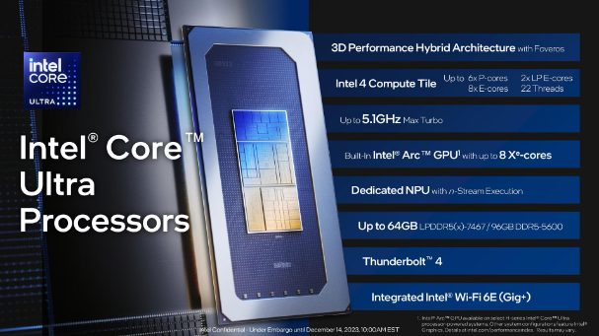
Core Ultra: Intel's Latest Architecture
1
Chiplet Design
Modular tile-based architecture for specialized processing
Intel 4 Process
Advanced 7nm manufacturing technology
NPU Integration
Dedicated Neural Processing Unit for AI workloads
Arc Graphics
Enhanced integrated graphics with ray tracing capabilities

Slide 8








Core Ultra Advantages
Performance
Optimized P-cores and E-cores for balanced computing
Efficiency
Advanced 4nm fabrication for superior power management
AI Acceleration
Dedicated NPU with 10 TOPS of AI performance
Graphics
Integrated Arc graphics with hardware ray tracing

Slide 9
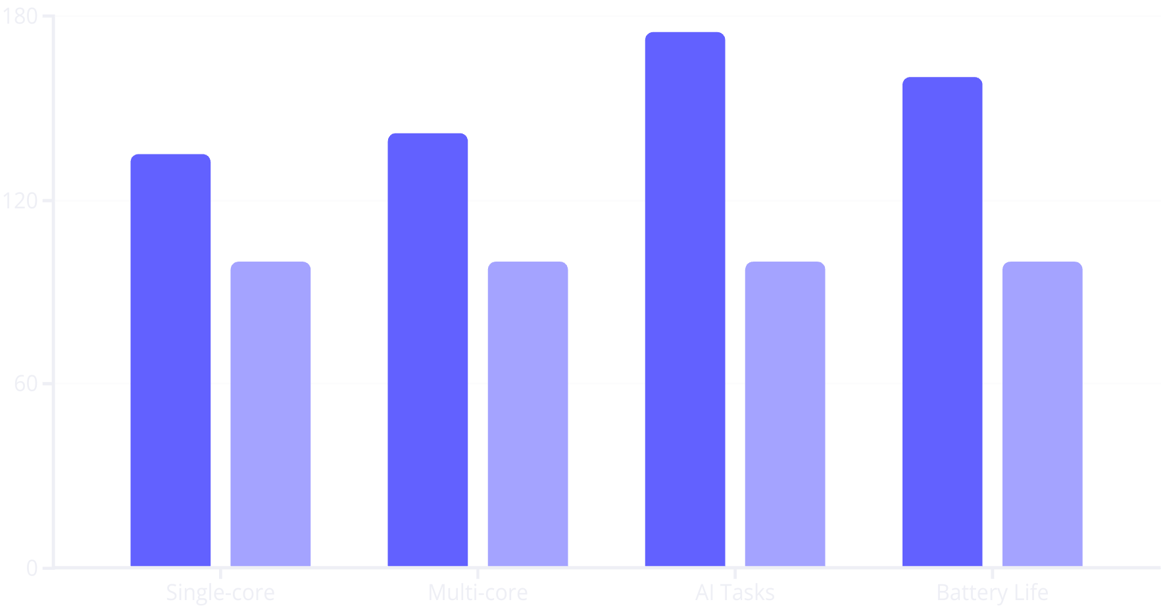
Core Ultra Performance Metrics
Core Ultra
Previous Gen

Slide 10

Evolution of Transistor Count
2.3K
29K
Intel 4004 (1971)
Intel 8086 (1978)
World's first commercial microprocessor
Foundation of x86 architecture
3.1M
20B+
Pentium (1993)
Core Ultra (2023)
First superscalar x86 design
Latest chiplet-based architecture

Slide 11




Architectural Evolution
Single Core Era
Multi-Core Revolution
1
Focus on increasing clock speeds for performance gains
Parallel processing with multiple CPU cores
2
Chiplet Design
4
Heterogeneous Computing
Specialized modules for different computing tasks
3
Performance and efficiency cores working together

Slide 12

Future of Intel Processing
Continued Miniaturization
Advanced process nodes below 3nm to pack more transistors in smaller spaces.
AI Integration
Enhanced neural processing units for on-device AI acceleration across all computing tasks.
Architectural Innovation
New computing paradigms beyond traditional von Neumann architecture, including quantum elements.
Power Efficiency
Next-generation designs optimized for performance-per-watt in cloud and edge applications.

